Slide 1
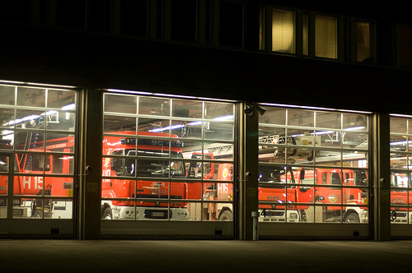
Rescue Station
Day 1

Slide 2
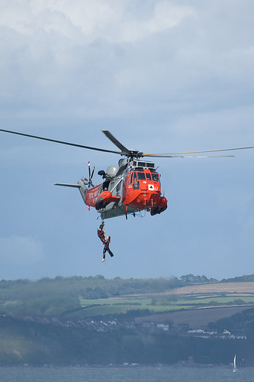
Jesus is the Rescuer

Slide 3
Reasons People Need to be Rescued
From fires
From car wrecks
From drowning
From shipwreck
Injured mountain climbers
From a plane crash
Lost in a forest

Slide 4
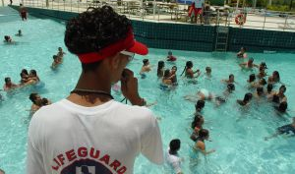
PEOPLE WHO RESCUE US
Lifeguards
Firefighters
Search & Rescue
Coast Guard
Civil Air Patrol
EMS

Slide 5
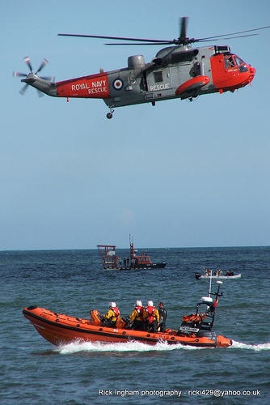
Another word for someone who rescues people is SAVIOR

Slide 6
It Takes a Savior to Save You

Slide 7
2nd Timothy 2:13 “Our great God and Savior, Jesus Christ”

Slide 8
John 4:42 “We have heard for ourselves and know that this [Jesus] really is the Savior of the world.”

Slide 9
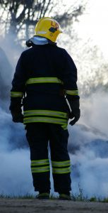
How Many Ways to be Saved Are There?
John 14:6 “Jesus told him, ‘I am the way, the truth, and the life. No one comes to the Father except through Me.’”
Because Jesus is God and because only Jesus was sinless.

Slide 10
What is the Bible word for rescuer?
Who is the rescuer?
Who is Jesus that He can rescue us?
Could anyone else have rescued us?
Why do we need to be rescued?

Slide 11
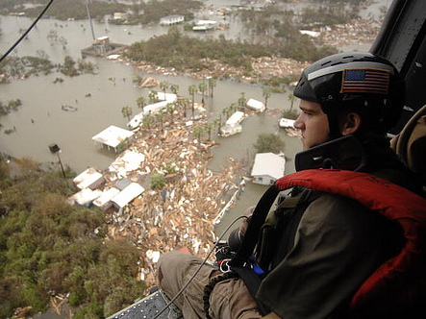

Slide 12
Rescue Station
Day 2

Slide 13
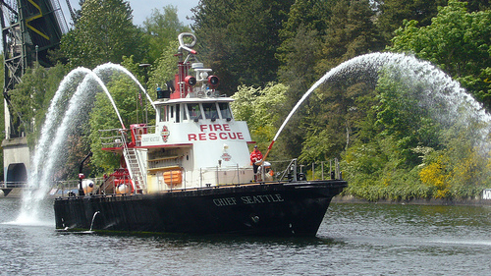
What Does it Take to be Rescued?
Fire Boat
Ambulance
Helicopter
Fire Truck
Ladders
Ropes
Search Dogs
Protective Clothing

Slide 14
What Do We Need to Be Rescued From?

Slide 15
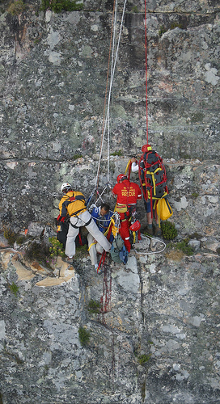
“You are to name Him Jesus, because He will save his people from their sins” – Matthew 1:21

Slide 16
What is Sin?
Sin is anything a person thinks, says, or does that is different from how God tells us to live.
Every sin deserves God’s punishment.
1st John 3:4 “Everyone who commits sin also breaks the law; sin is the breaking of law.”

Slide 17
Can an Honest Judge Let His Friends Off?
Psalm 7:11 “God is a righteous judge and a God who shows his wrath every day.”
There is No Such Thing as an Unpunished Sin
Nahum 1:3b “The Lord will never leave the guilty unpunished”

Slide 18
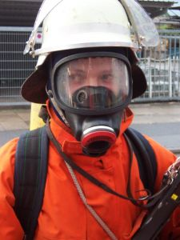
Why Did Jesus Come to Earth?
To die on the cross as a substitute for our sins. By taking our punishment, He secured forgiveness for our sins.
1st Corinthians 15:3-6 “Christ died for our sins”

Slide 19
It Takes the Cross To Be Rescued
Romans 5:6 “For while we were still helpless, at the appointed moment, Christ died for the ungodly.”

Slide 20
Why do we need to be rescued? From what?
Who is the rescuer?
Is there any other one who can rescue us?
Who is Jesus that He can rescue us?
How does Jesus rescue us?

Slide 21
Rescue Station
Day 3

Slide 22
How is Rescue Possible?
Salvation is possible because Jesus died on the cross and shed His own blood to obtain forgiveness of our sins.
Salvation is offered freely to all who accept Jesus Christ as Lord and Savior.

Slide 23
What Does it Mean To be Saved?
That God has forgiven us of our sins.
That we will go to Heaven.
That God makes us to be born again and changes our lives.

Slide 24
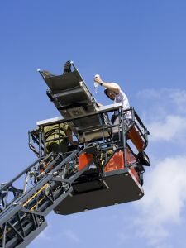
To Rescue Us, God Changes Us from the Inside-Out
John 3:3 “Jesus replied, ‘I assure you: Unless someone is born again, he cannot see the kingdom of God.’”

Slide 25
What Does “Born Again” Mean?
The Holy Spirit makes people alive to God and fixes their “want to.”
This changes the direction of a person’s life.

Slide 26
2nd Corinthians 5:17 “Therefore if anyone is in Christ, there is a new creation; old things have passed away, and look, new things have come.”

Slide 27
Why do we need to be rescued? From what?
Who is the rescuer?
How does Jesus rescue us?
Will a person who has been born again want to keep living the same old way?

Slide 28
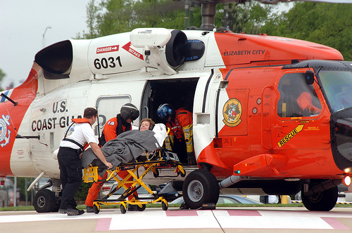

Slide 29
Rescue Station
Day 4

Slide 30
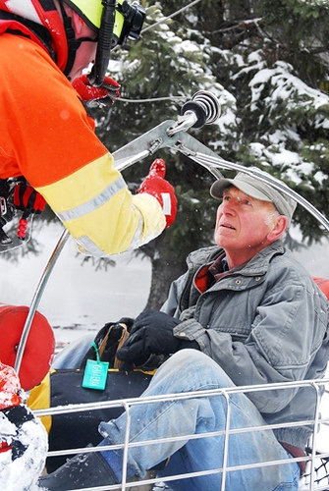
To Be Rescued, You Have to Agree

Slide 31
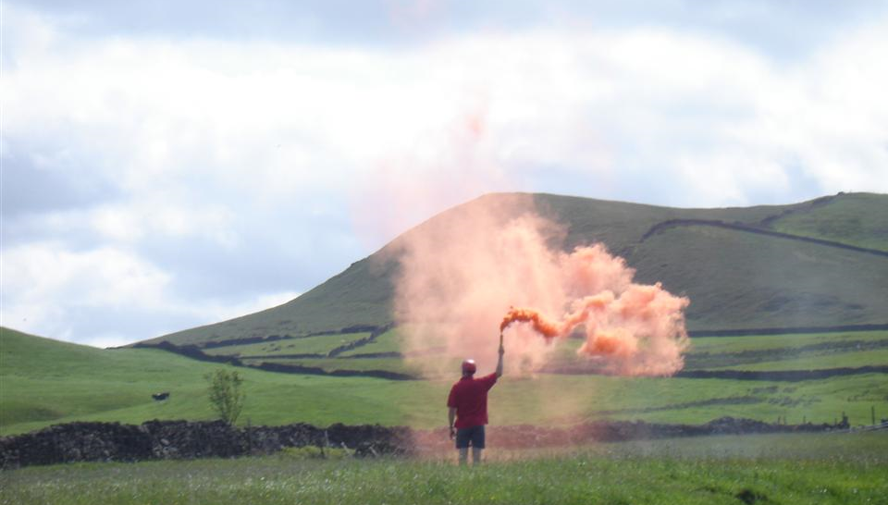
Ways People Ask to Be Rescued
Dial 911
Call “Mayday” on the radio
Do SOS in Morse code
Shoot up a flare
People on a life raft put a colored dye in the water
Colored smoke

Slide 32
You Have To Agree to be Rescued
John 1:11-2 “He came to His own, and His own people did not receive Him. But to all who did receive Him, He gave them the right to be children of God, to those who believe in His name”

Slide 33
But No One Wants To Be Rescued
No one wants to be rescued until God works in their hearts… So, God does work in people’s hearts and calls them to Himself

Slide 34
God Calls Us
“No one can come to Me unless the Father who sent Me draws him” — John 6:44

Slide 35

God Calls People to Himself
I Thessalonians 2:12 “We encouraged, comforted, and implored each one of you to walk worthy of God, who calls you into His own kingdom and glory.”

Slide 36
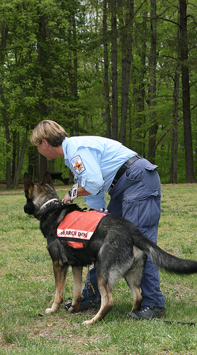
How Do We Respond In Order to be Saved?
Mark 1:15 “The time is fulfilled, and the kingdom of God has come near. Repent and believe in the good news!”
Acts 20:21 “…repentance toward God and faith in our Lord Jesus.”

Slide 37
What is Saving Faith?
Faith isn’t just knowing the right answers to questions
Faith is not just believing with one’s mind certain facts about God.

Slide 38
What is Repentance?
Repentance is a change of attitude…
A change of heart of mind…
…in which the sinner turns to God from sin.

Slide 39
What is Repentance?
Acts 3:19 “Therefore repent and turn back, that your sins may be wiped out so that seasons of refreshing may come from the presence of the Lord”

Slide 40
Repentance is Not…
It‘s not just saying we‘re sorry
It is facing up to the truth
It is turning from our sin
It is turning to God

Slide 42
Rescue Station
Day 5

Slide 43

The ABC’s of Becoming a Christian
Admit to God you are a sinner
Believe that Jesus is God’s only Son
Confess Jesus as your Lord and Savior openly

Slide 44

Where Are You Today and What Do You Want to Do About It?

Slide 45
Becoming a Christian Is a Commitment
Luke 9:23 “Then he said to them all, ‘If anyone wants to follow after me, let him deny himself, take up his cross daily, and follow me.’”

Slide 46
God’s Promise to Those Who Ask to Be Rescued
“If we confess our sins, He is faithful and righteous to forgive us our sins and to cleanse us from all unrighteousness”
- 1st John 1:9

Slide 47

When a Person Becomes a Christian
People are saved when they trust Jesus, and not anything they can do, to make them a Christian.

Slide 48

Where Are You Today?
I’m not interested in becoming a Christian at this time.
I’m beginning to understand, but I’m not yet ready to become a Christian.
I am very interested, but have questions about it. Can you help?

Slide 49
Where Are You Today?
I haven’t done it yet, but Jesus is working in my heart and I am ready to commit my life to Jesus right now.
I think I have become a Christian, but now I need to be baptized and join the church.

Slide 50
Where Are You Today?
I have already become a Christian. After that I was baptized and joined the church, just like you told us about.

Slide 51
What We Feel When God Has Drawn & Called Us to Himself
My big questions have all been answered.
God is working in my heart, telling me this is what I ought to do.
I feel nervous about it, but I need Jesus.
This is what I really want.
I’m ready to surrender my life to Jesus now!

Slide 52
Is This Your Day to be Rescued?

Slide 53
Rescue Station

